Slide 1
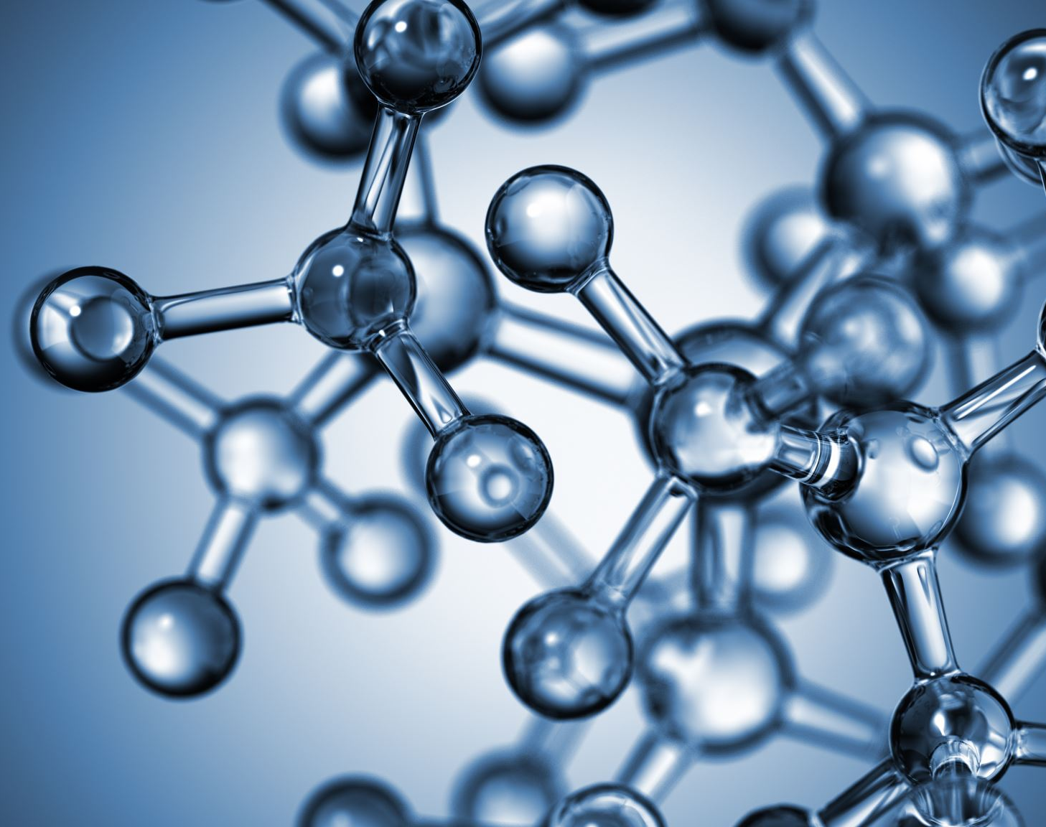
Midterm Project “The adventure of Nitrogen Atom”
Aining Liu

Slide 2

Inspiration and Concept
The "active" nitrogen added through human activities every year causes a series of environmental issues such acidification of water bodies and greenhouse gas emissions problem.
Goal of this project:
An informative view of the nitrogen cycle in nature
Inspire players to think of related ecology issues.
Motivates creative thinking when tackling each level

Slide 3
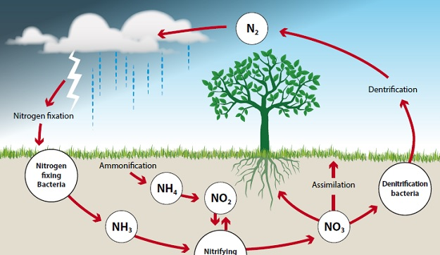
Mechanic
Create polygons to help particles collide
Polygon and particle adheres to physical laws (gravity, collision, etc.)
Polygons must be concave
Polygons can break into triangles
Three levels form a cycle (after level 3 come back to level 1, simulates the actual nitrogen cycle)

Slide 4
Some details
Each particle represents a chemical substance (with their chemical formula written on it)
The background of each level adheres to the actual environment that each chemical process occur: atmosphere, ground, lightning/rainy
However the color and size of each particle don’t follow scientific description. Too many particles do not have a color in real life (N2, O2, H2……)

Slide 5
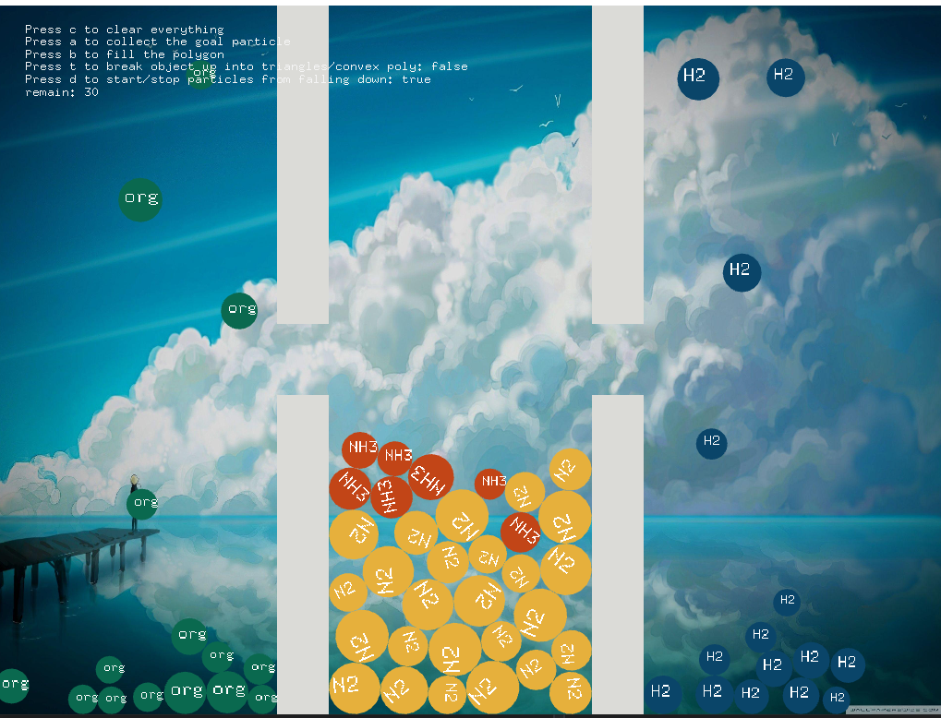
Level 1 – Nitrogen Fixation
The process that converts free N2 (nitrogen in the atmosphere) into nitrogen compounds
Left: microorganism
Right: H2
Middle: free N2
Goal: make N2 in the middle collide with org or H2

Slide 6
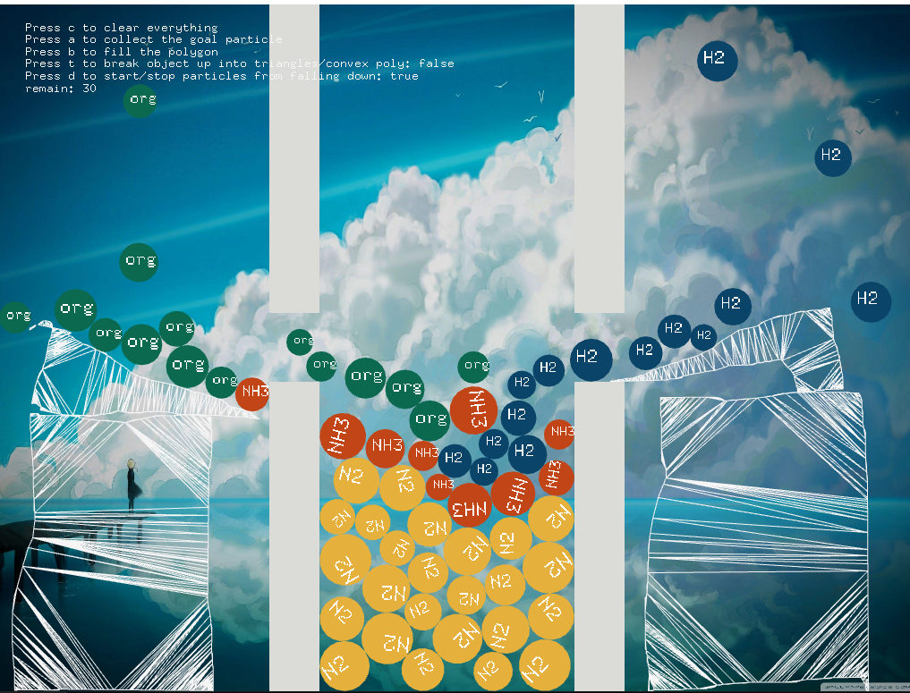
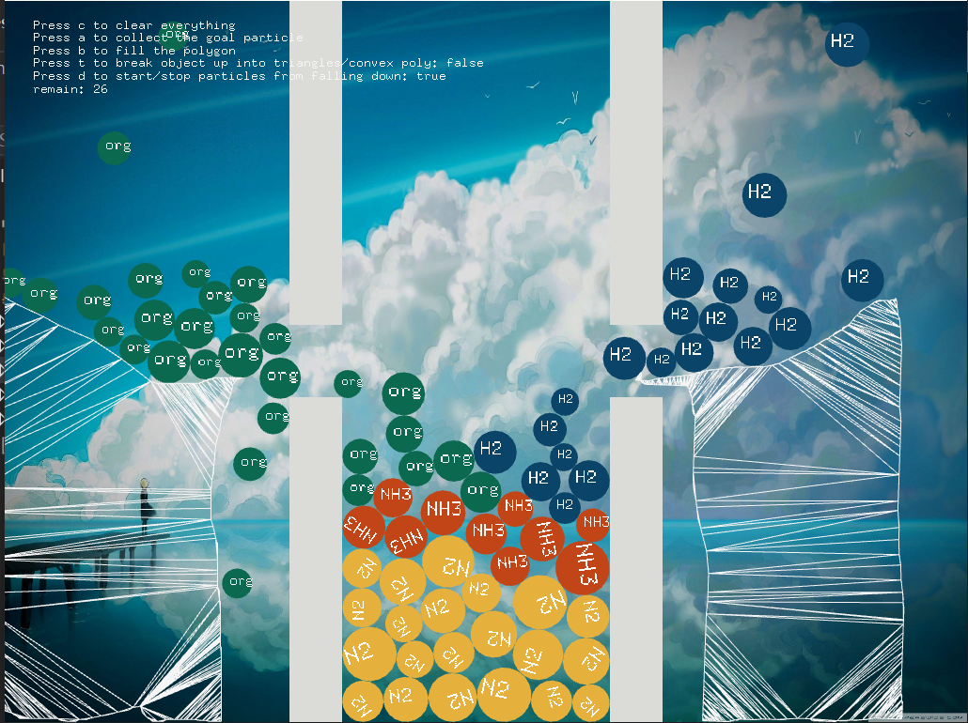
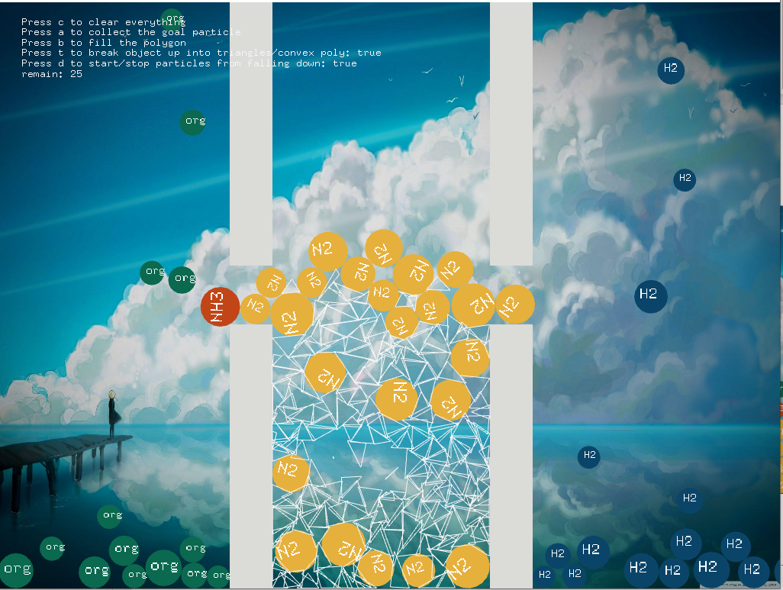
Possible solutions
Outside in
-create a ramp, utilize gravity
Inside out
-scattered triangles to make N2 “float” outside

Slide 7
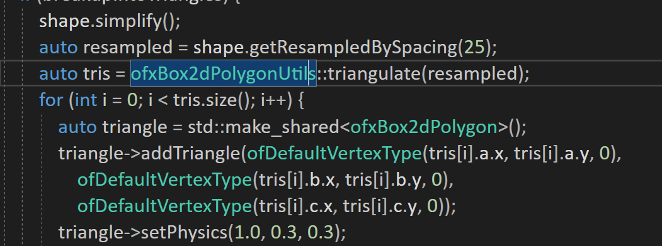
Coding detail
ofxbox2d Addon
Polygon->triangles

Slide 8
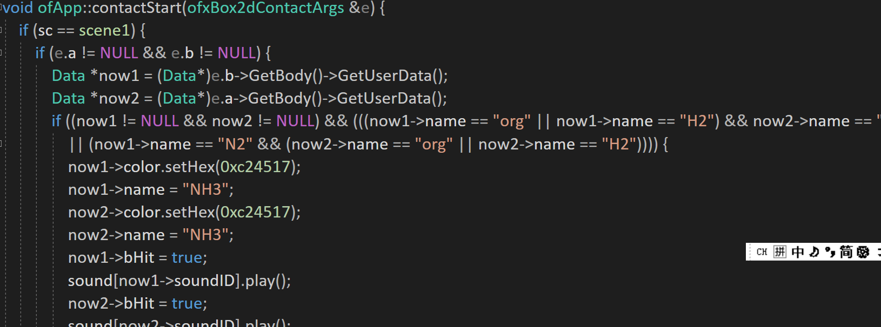
Coding detail
A little sound effect to make it more interactive
“player feedback”
ofxbox2d Addon
Particle collision

Slide 9
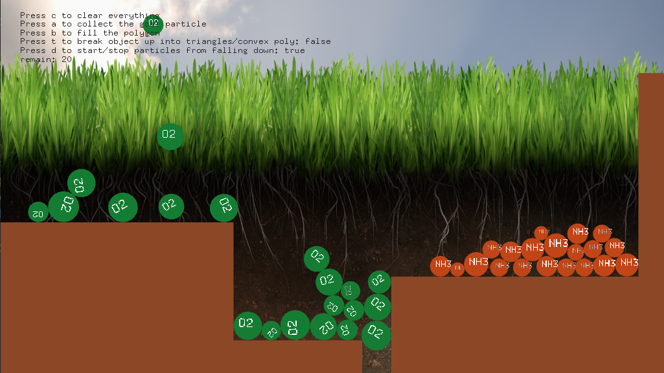
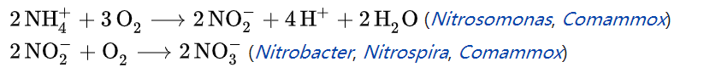
Level 2 - Nitrification
Nitrification is an important step in the nitrogen cycle in soil
Left: O2
Right: NH3 (from previous level)
Goal: O2 collide with NH3 to get NO3-

Slide 10
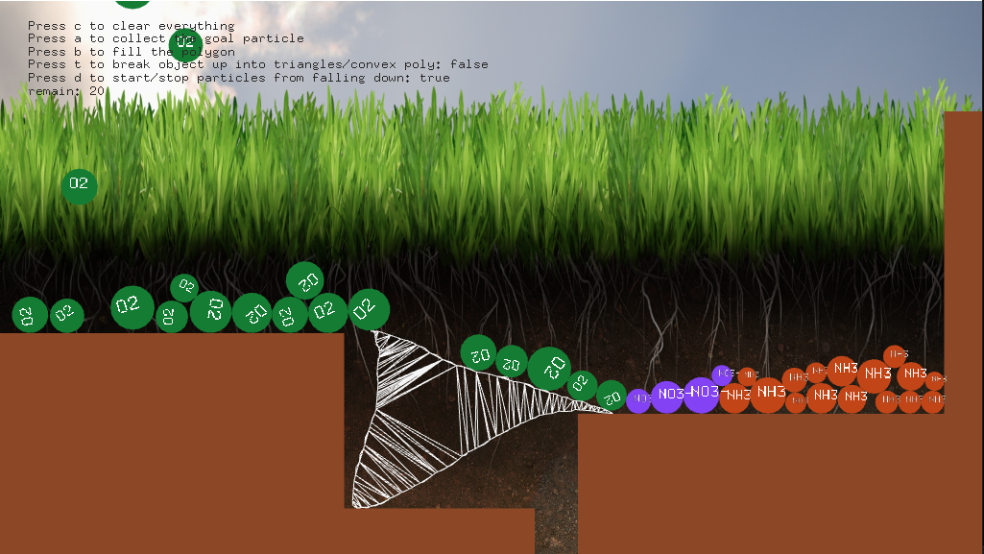
Possible Solution thought process: don’t want O2 to fall in the gap, so fill in the gap

Slide 11
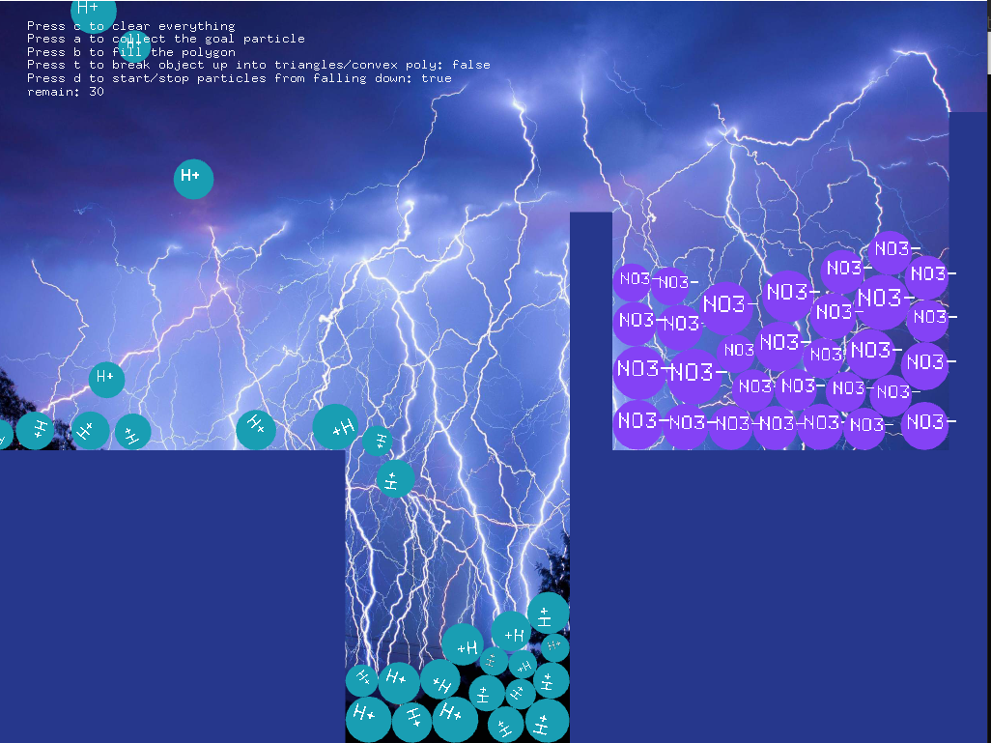
Denitrification
We got N2 again! Cycle complete!
In nature, denitrification can take place in both terrestrial and marine ecosystems. Typically, denitrification occurs in anoxic environments, where the concentration of dissolved and freely available oxygen is depleted.
2 NO₃⁻ + 10 e⁻ + 12 H⁺ → N₂ + 6 H₂O
Left: H+
Right: NO3- (from previous level)
Goal: NO3- collide with H+ to get N2

Slide 12
At Last……
Repeat to the first level
Thank you for listening (●’◡’●)

